Slide 1
Build Radon Out:
Adopt Appendix AF
City Council South Lake Tahoe
November 5, 2024
by Jeff Miner
Notes:
The Goal of this presentation is to convince the South Lake Tahoe City Council to approve the adoption of Appendix AF of the International Residential Code to our Building Codes, The basic reasons are that 1.) Radon causes lung cancer; 2.) We have a lot of it here; and 3.) It is easy to do.

Slide 2
Appendix AF of IRC
Requires RRNC - Radon Resistant New Construction techniques on all new 1 and 2 family residential construction
Requires Radon Testing as part of final inspection.

Slide 3

Radon At Tahoe

Slide 4
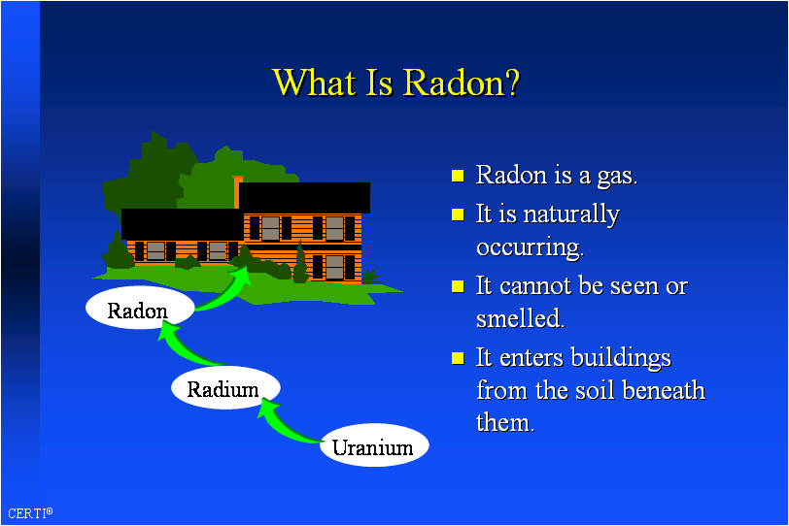
What is Radon?

Slide 5
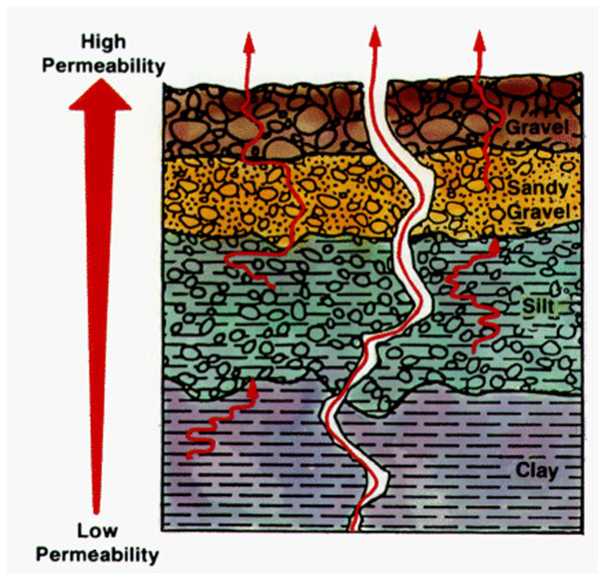
Radon Movement

Slide 6
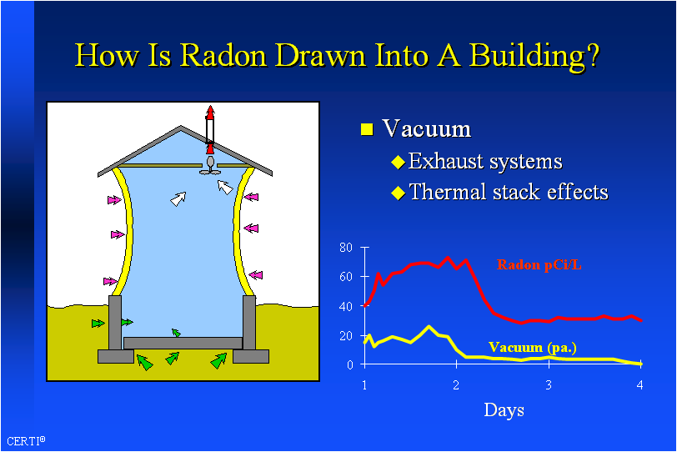

Slide 7
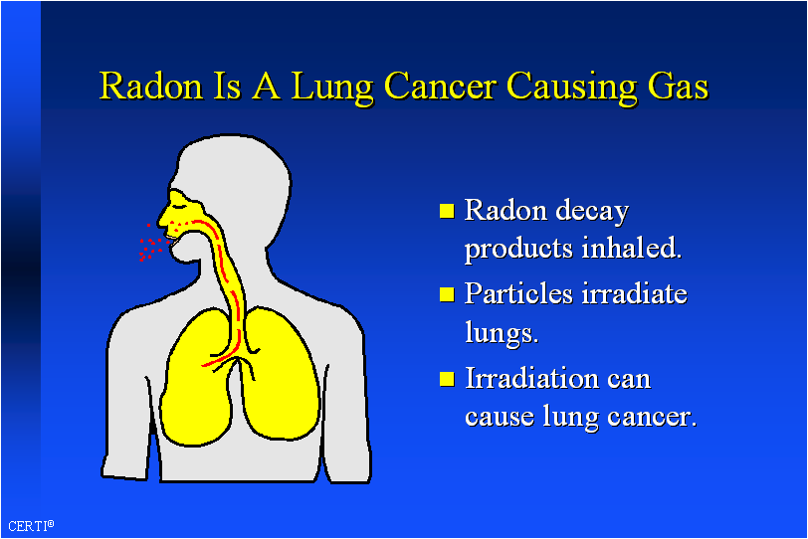

Slide 8
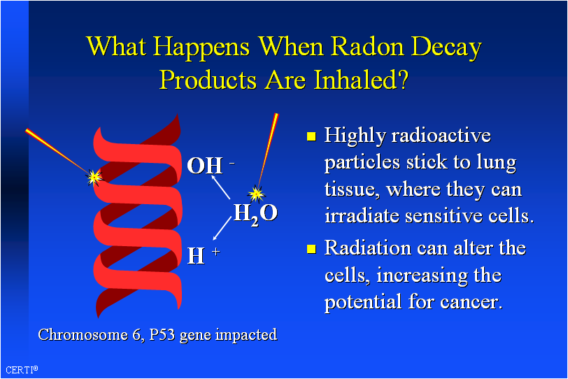

Slide 9
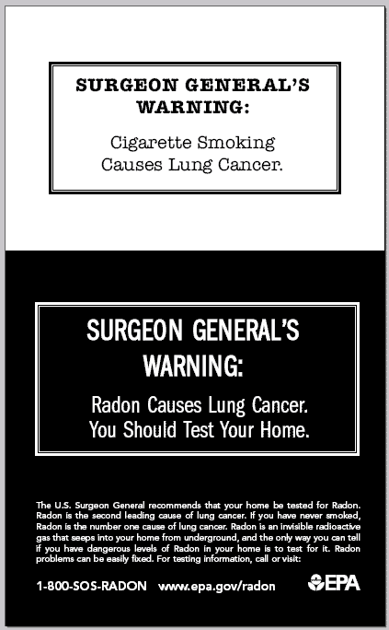
U.S. Surgeon General Radon Warning
Class I Carcinogen

Slide 10
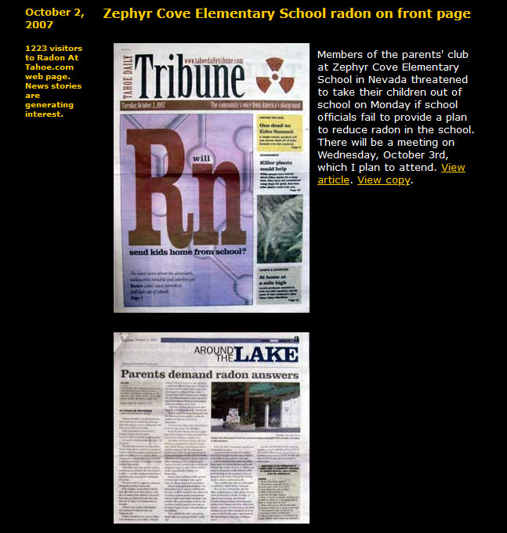
2007 Zephyr Cove Elementary School Radon

Slide 11

2006 Tahoe Radon Study

Slide 12
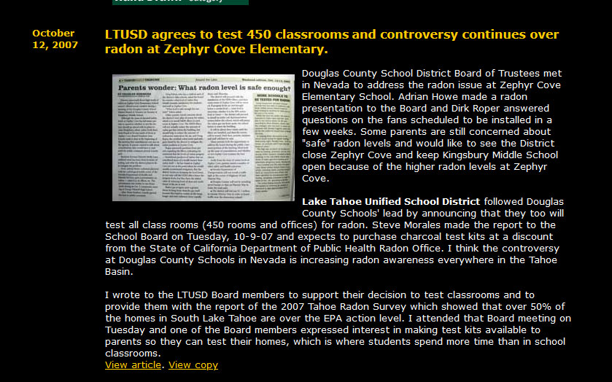
2007 LTUSD Tests 450 Classrooms

Slide 13
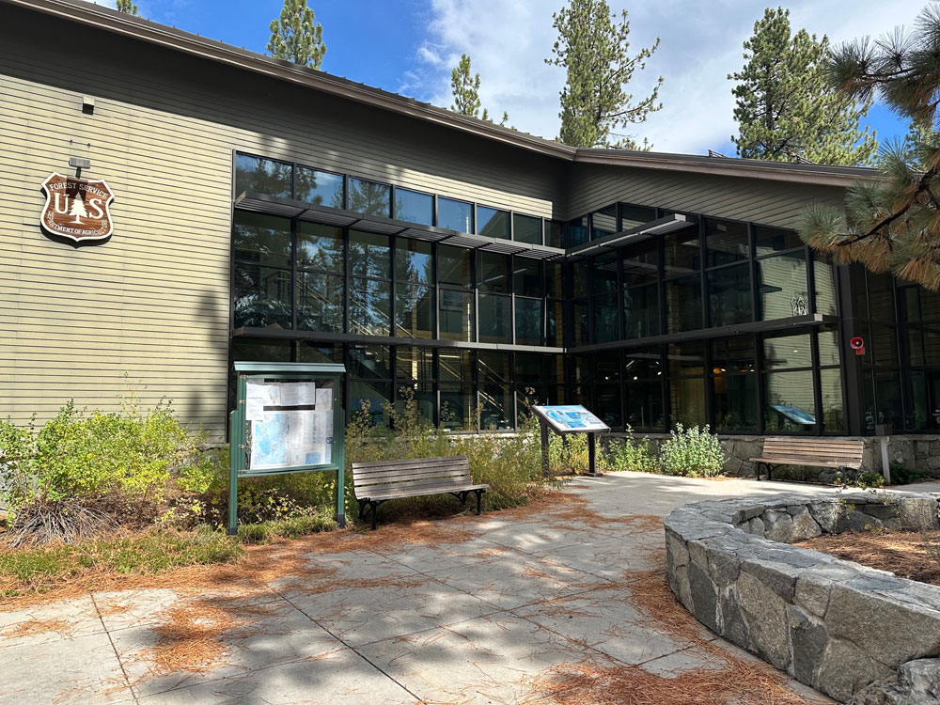
2008 USFS Supervisor’s Building

Slide 14
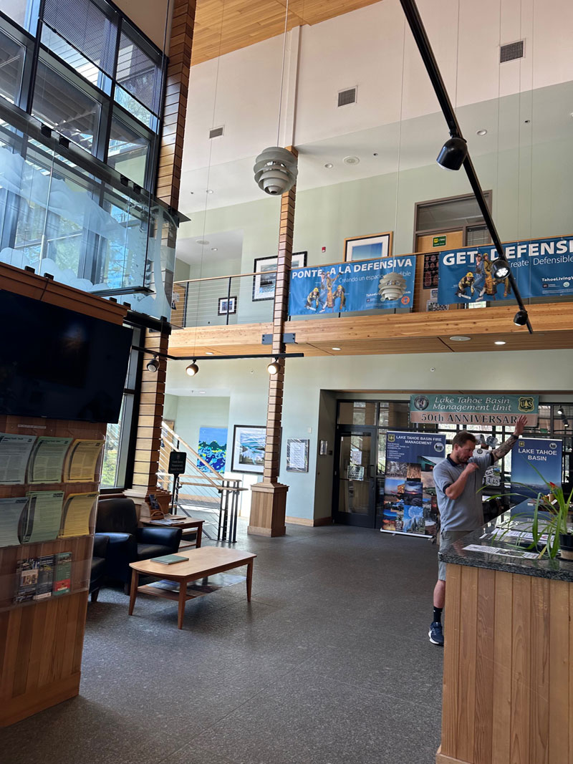
USFS Lobby

Slide 15
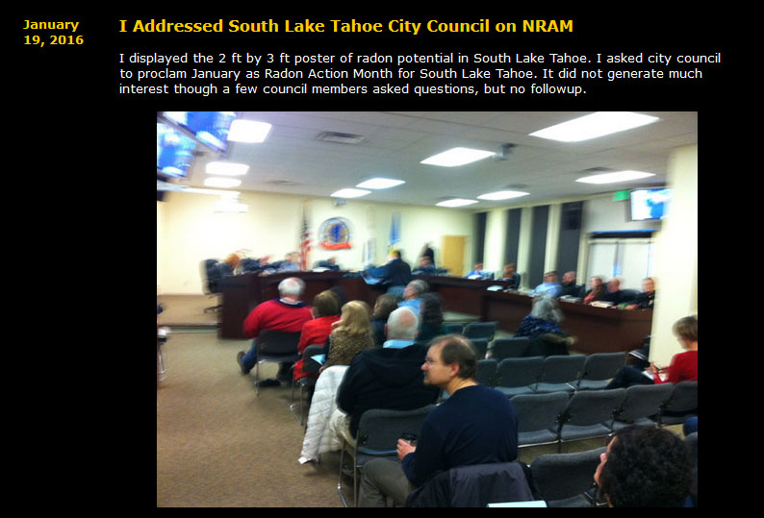
2016 SLT City Council

Slide 16
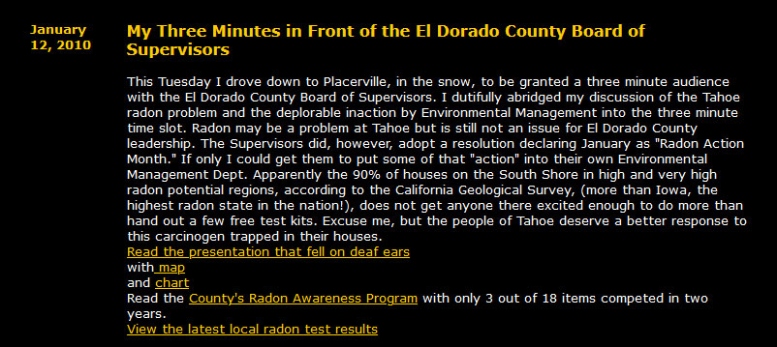
2010 El Dorado County
Board of Supervisors

Slide 17
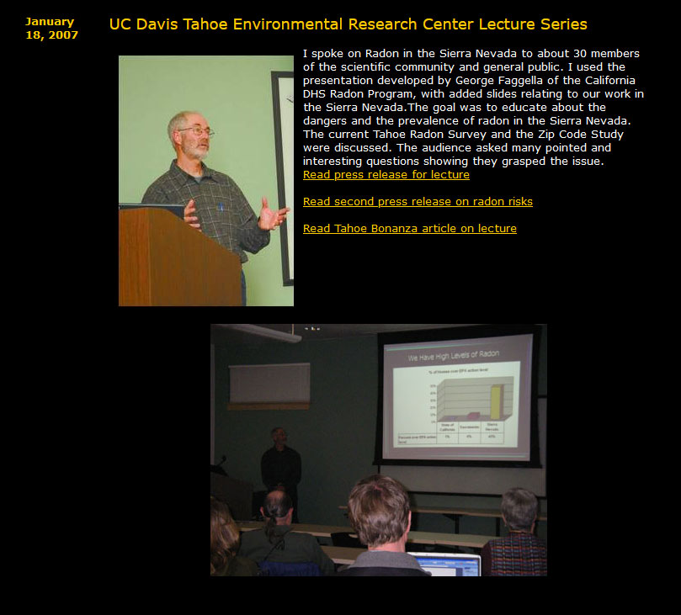
UC Davis TERC Lecture 2007

Slide 18
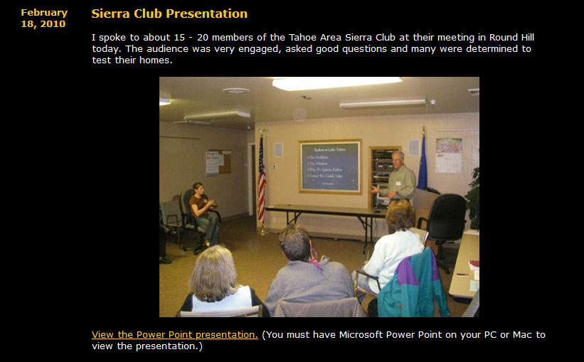
Sierra Club 2010

Slide 19
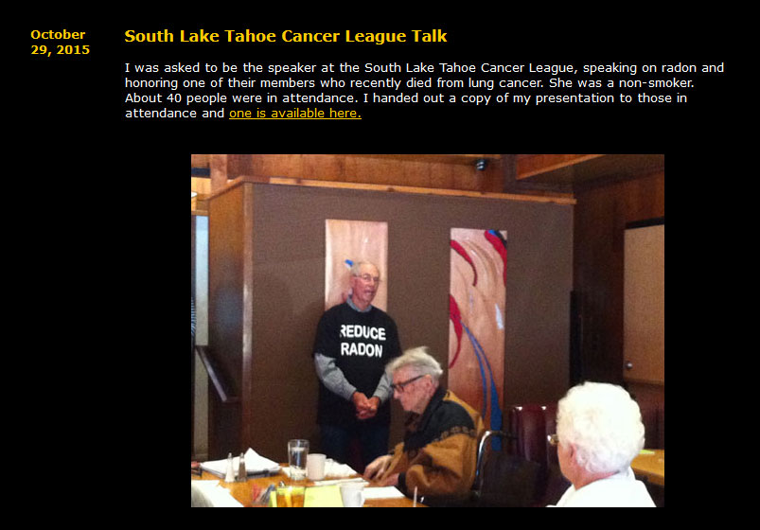
2015 SLT Cancer League

Slide 20
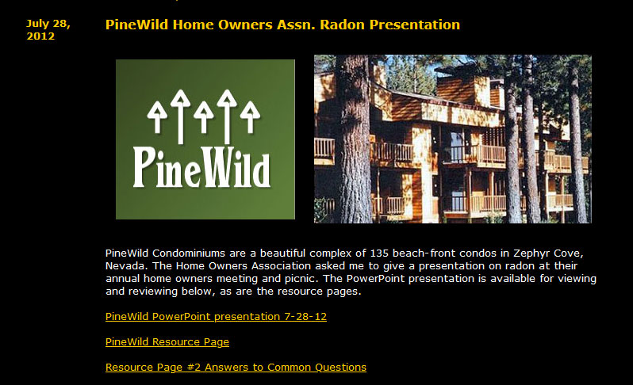
2012 PineWild Condominiums

Slide 21
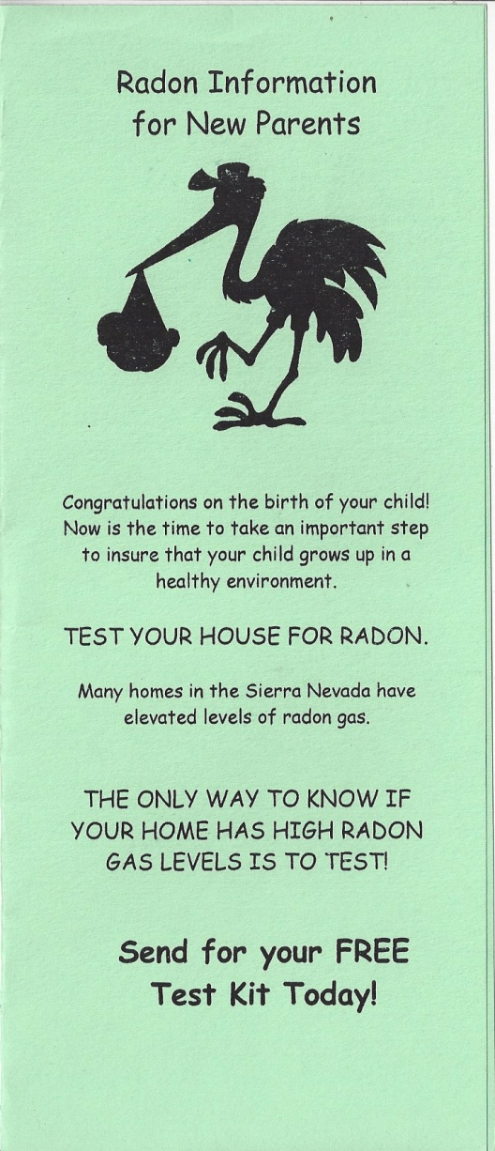
2019 Barton Patient and Family
Advisory Council

Slide 22

Barton Newborn Radon Program

Slide 23
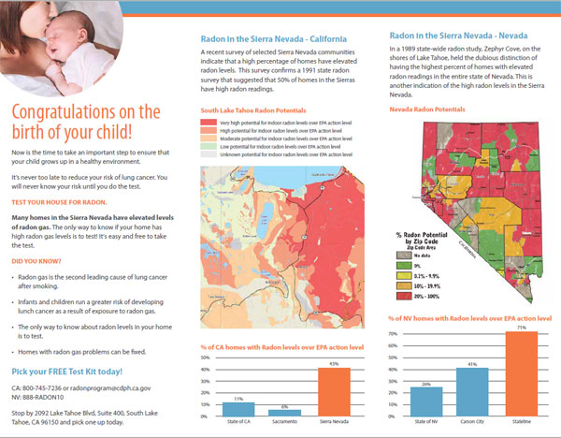
Barton Newborn Radon Program

Slide 24
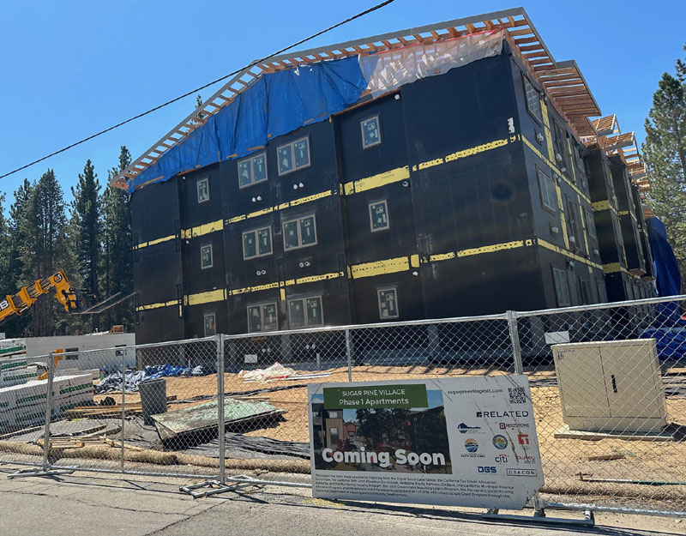
Sugar Pine Village
SLT Work Force Housing

Slide 25
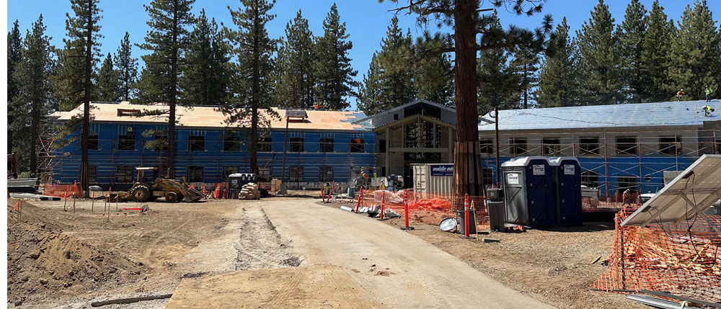
LTCC Student Dorms

Slide 26
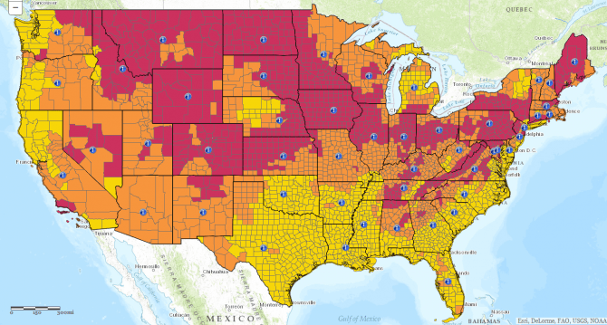
EPA Radon Map by County 1980

Slide 27
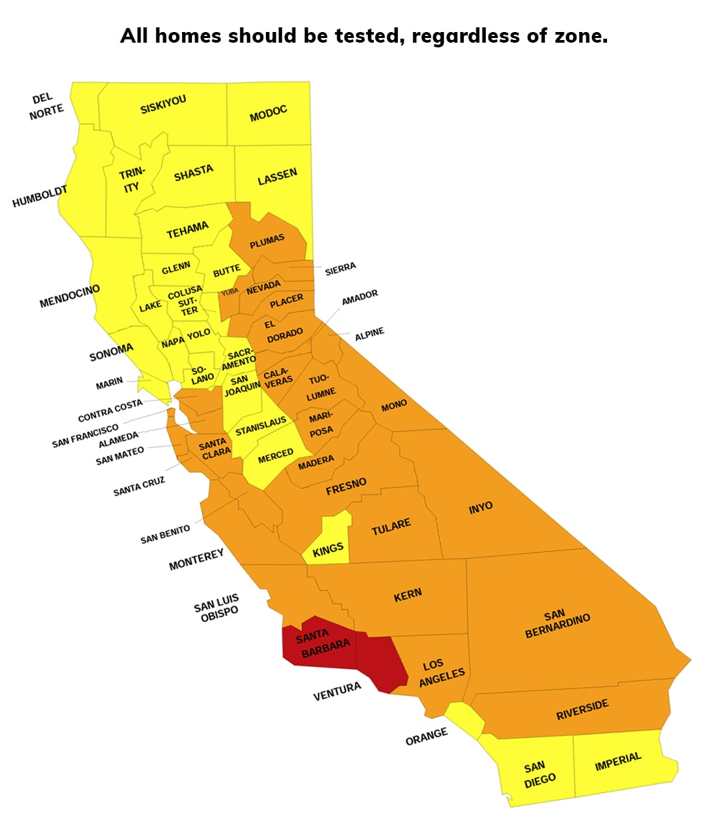
EPA California Radon Map

Slide 28
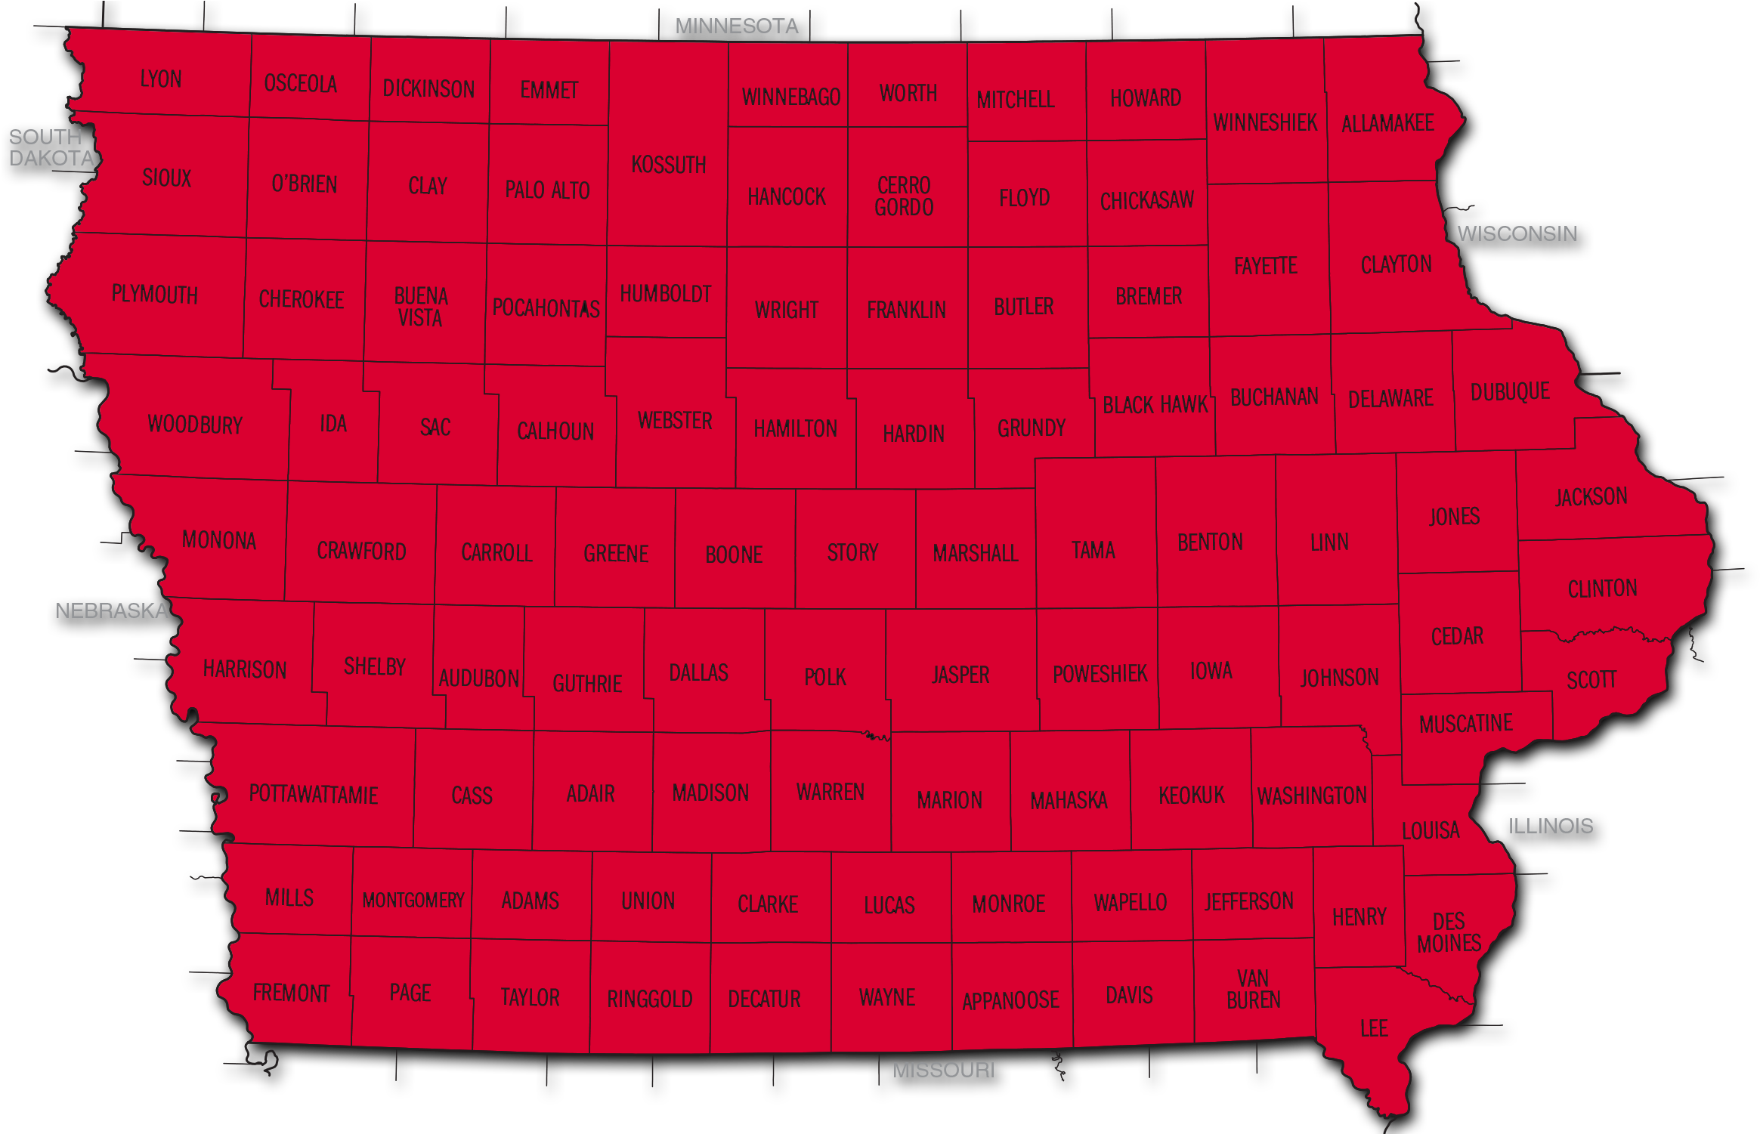
EPA Iowa Radon Map by County
71% of homes above 4 pC/L

Slide 29
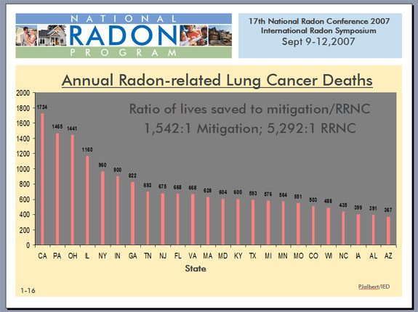
Most Radon Deaths are in California

Slide 30
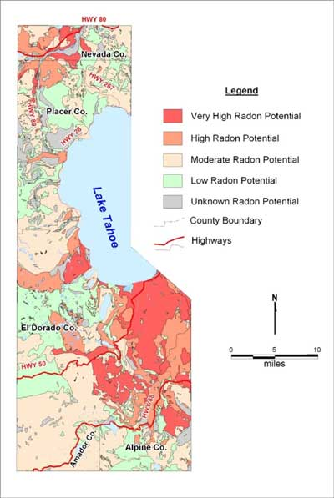
Lake Tahoe Radon
Potential

Slide 31
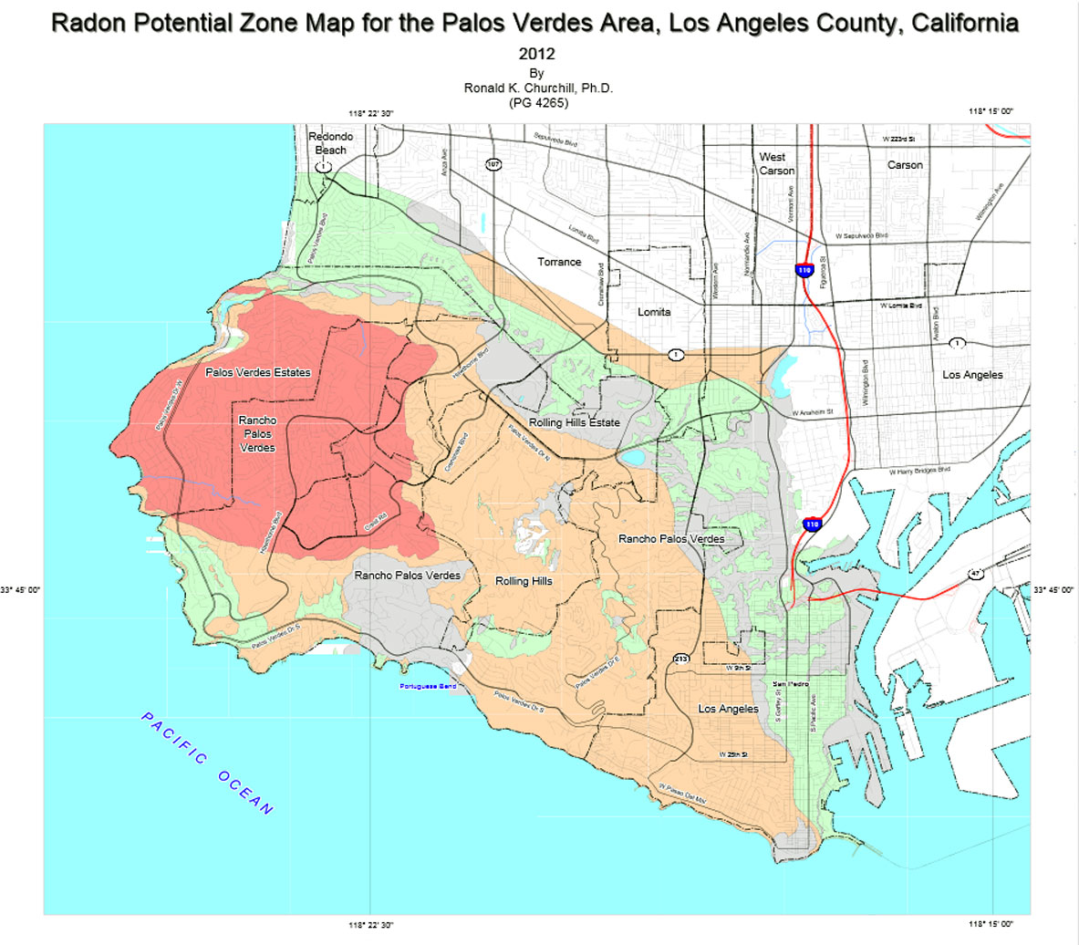
Palos Verdes Area of LA County

Slide 32
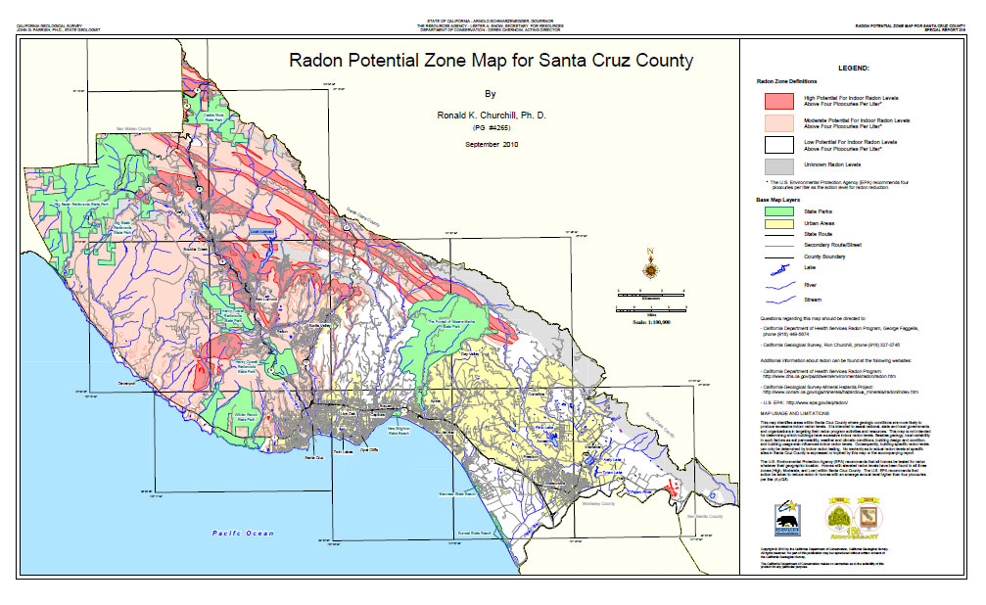
Santa Cruz County

Slide 33
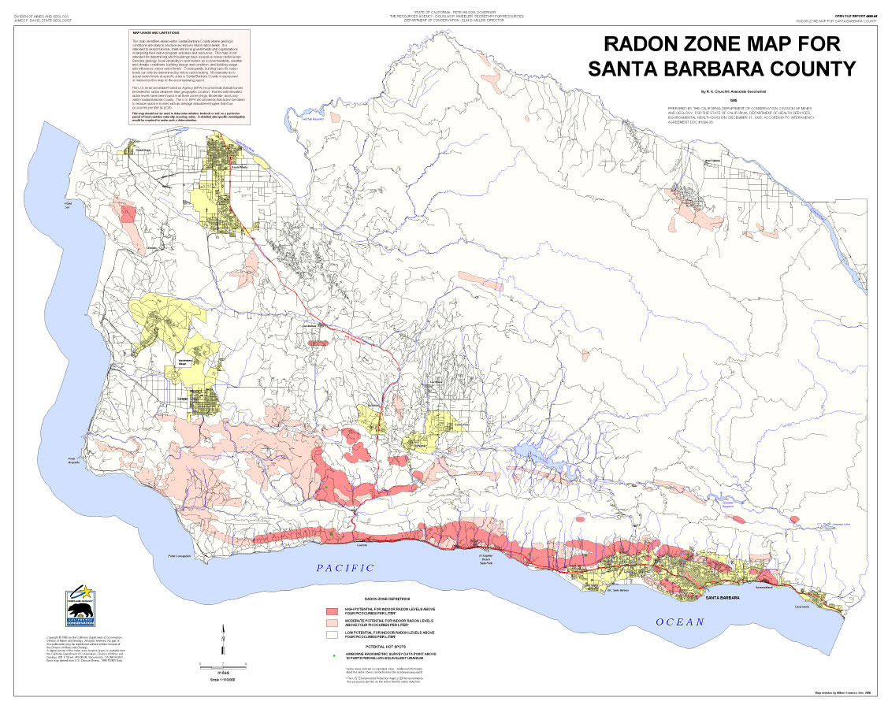
Santa Barbara County

Slide 34
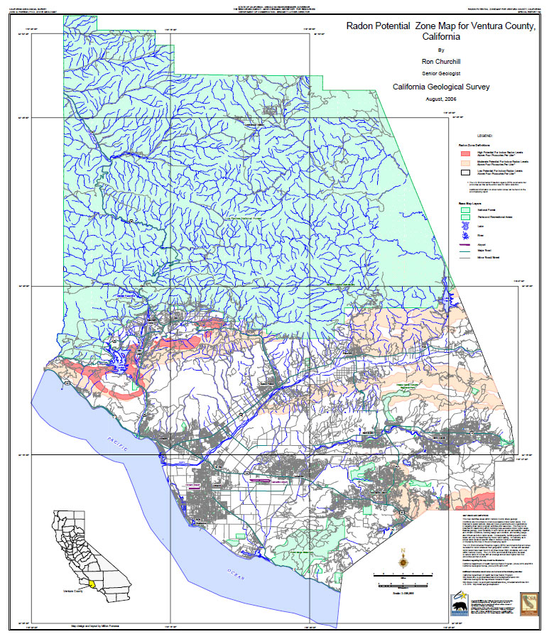
Ventura County

Slide 35
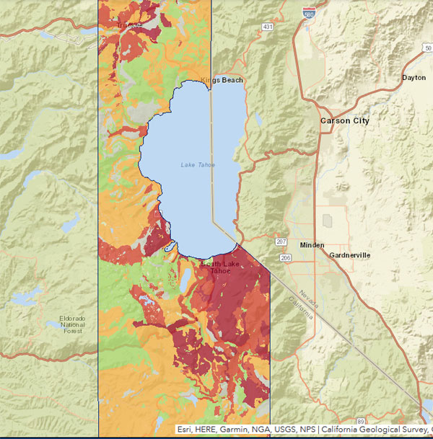
Lake Tahoe Area Radon

Slide 36
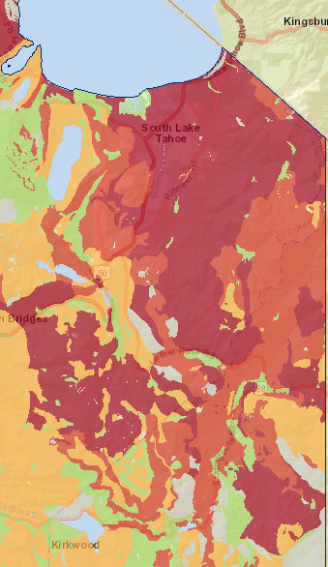
South Lake Tahoe
Radon Map

Slide 37
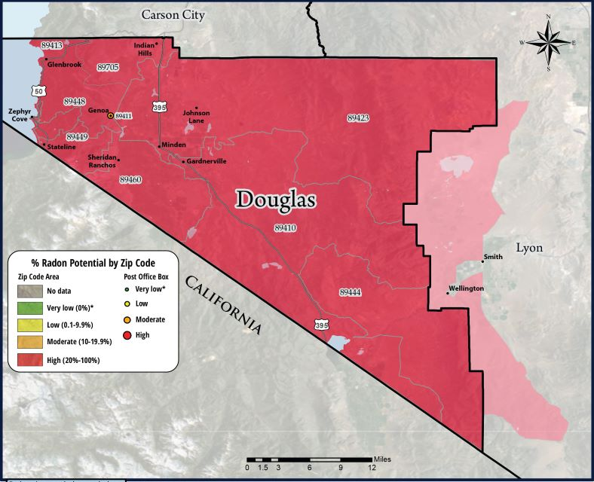
Douglas County Radon Tests by Zip Codes

Slide 38
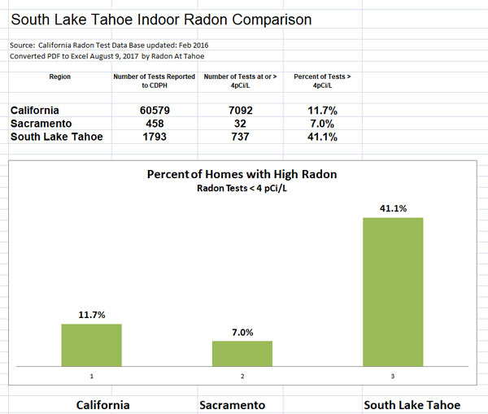
Radon Tests

Slide 39
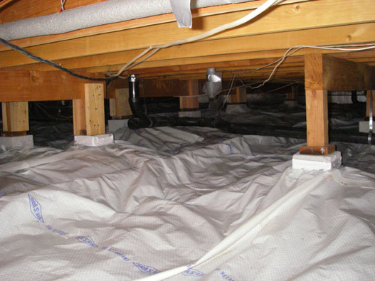
How To Fix an Existing Building
Barrier Cloth

Slide 40
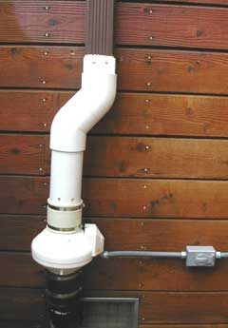
Radon Fan

Slide 41
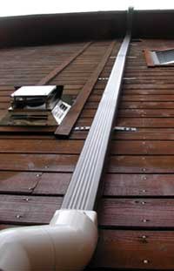
Vent Pipe

Slide 42
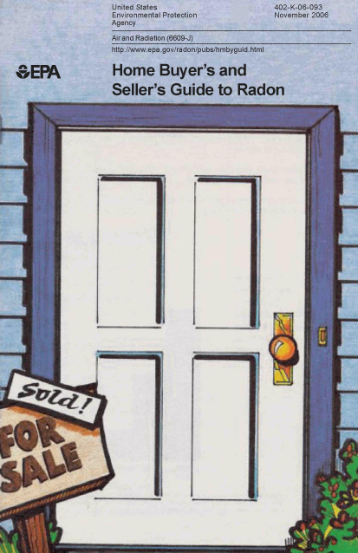
Home Buyers are Not Required to Test for Radon in “Moderate” Risk Areas

Slide 43
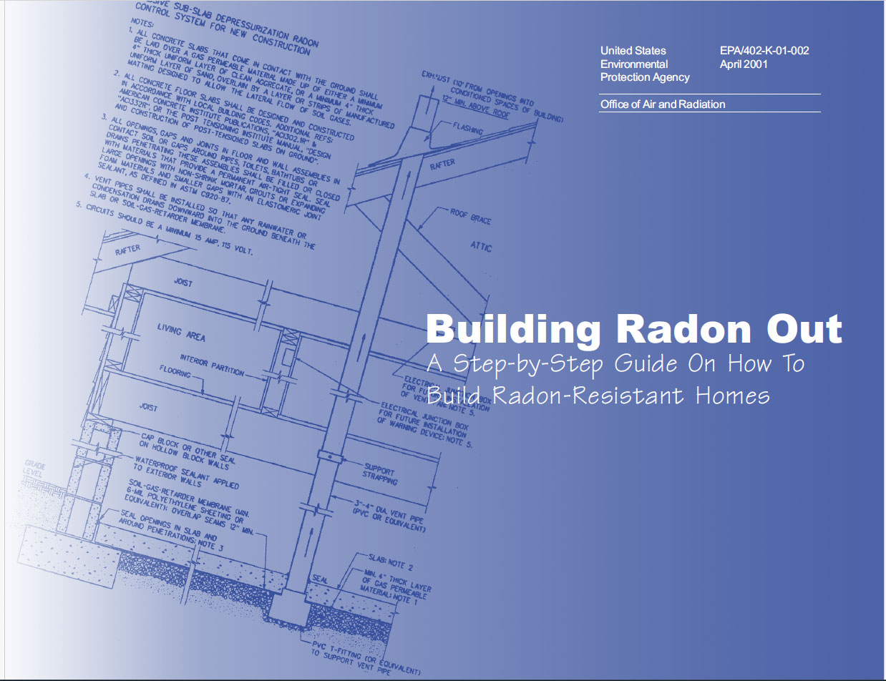
EPA Radon Guidelines

Slide 44
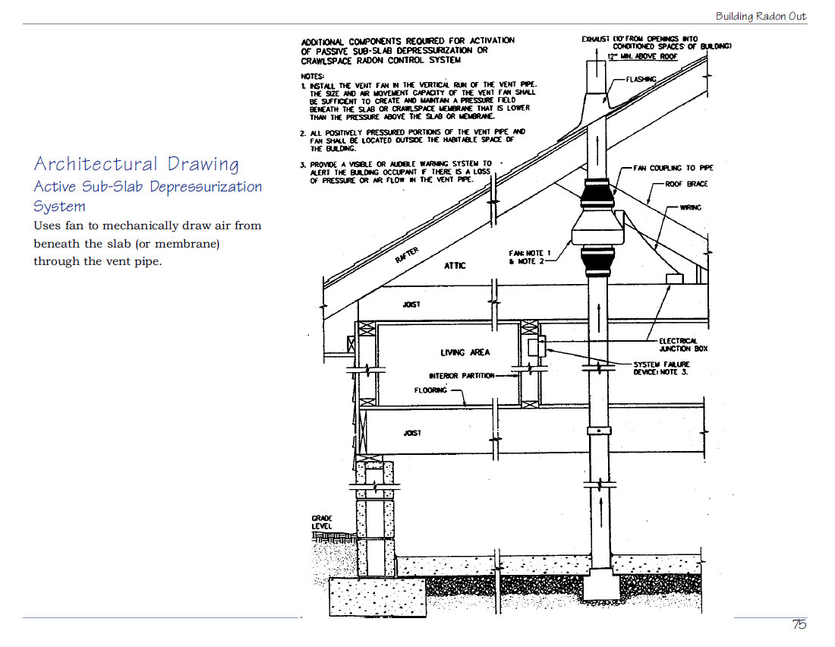
Architectural Drawings

Slide 45
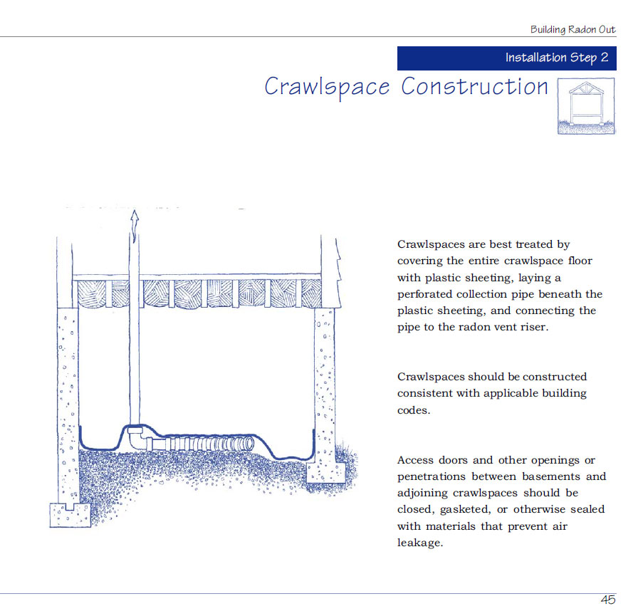
Crawlspace Construction

Slide 46
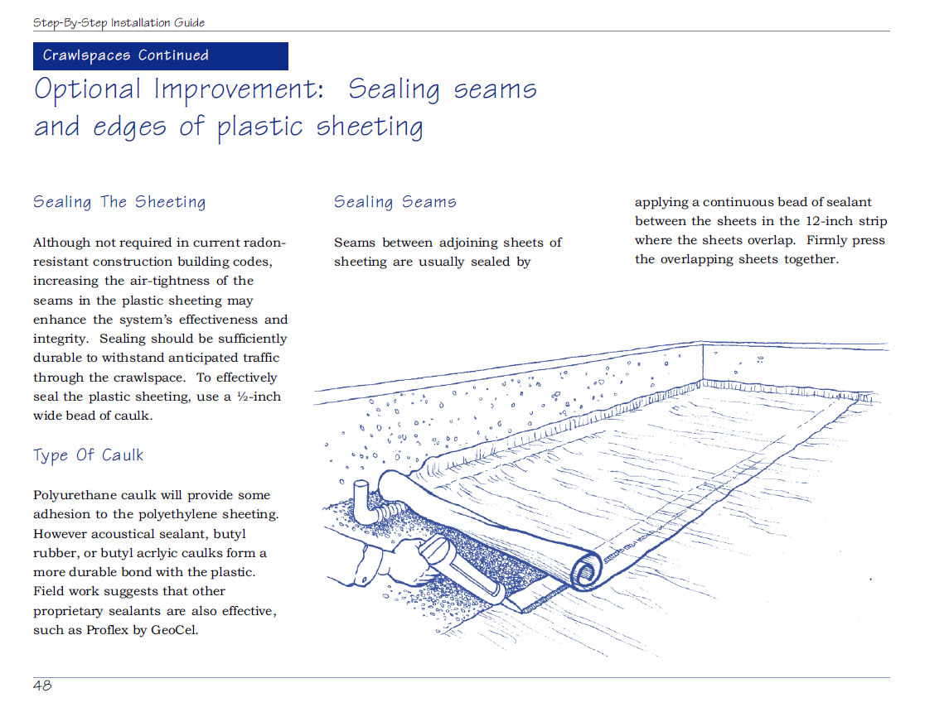
Seal Seams of Barrier Cloth

Slide 47
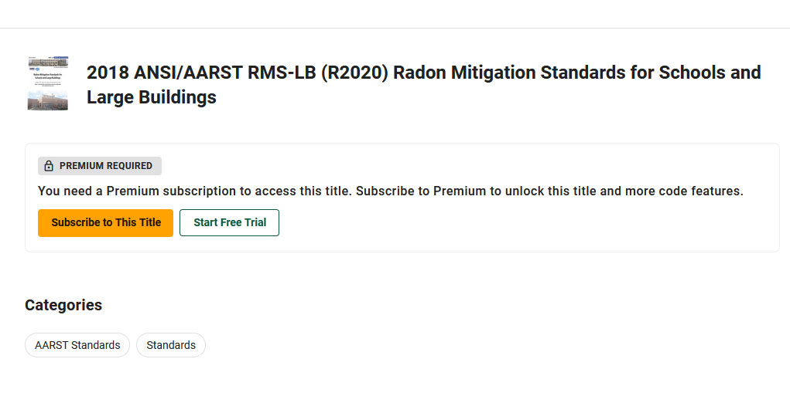
Radon Standards for Large Buildings

Slide 48
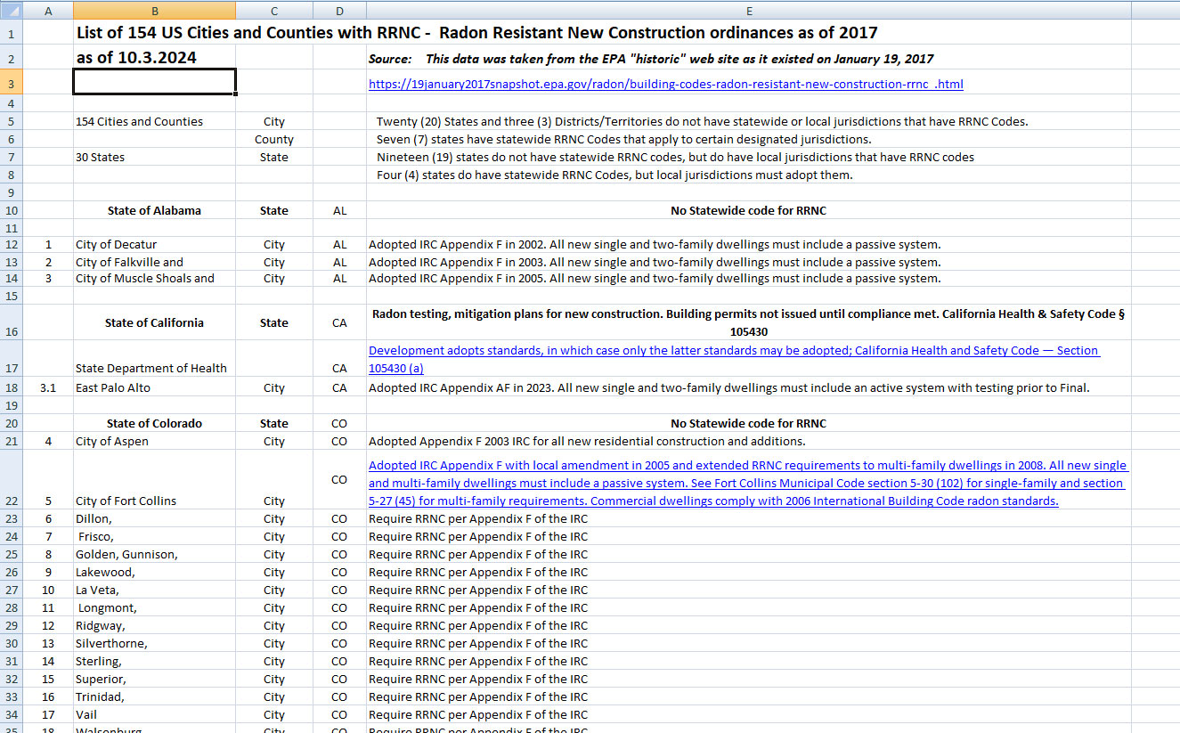
154 RRNC Cities and Counties

Slide 49
What does Appendix AF do?
It requires RRNC - Radon Resistant New Construction on all new residential construction.
It requires Radon Testing as part of final inspection.

Slide 50
Why Adopt Appendix AF ?
Radon is dangerous.
We’ve got a lot of it here.
We have a high population.
It’s simple to Build Radon Out.
Testing insures it is working
Adopt Appendix AF!
Thank You!

Slide 51
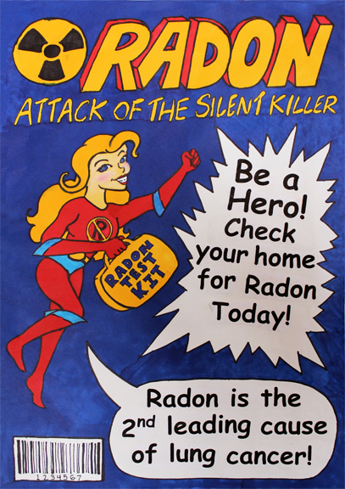
Be a Hero!
Adapt Appendix AF!

